Slide 1
New Aerospace Technologies
ALTERNATIVE PROPULSION ENGINEERING CONFERENCE

Slide 2
Alexander V. Frolov
Alexander V. Frolov was born
in the Saratov region, September 25, 1962. Graduated as wireless telecom engineer in 1984, specializing in high frequency wireless communications.
Officer of Russian Ministry of Defense
from 1984 to 1989, then worked in telecommunications companies in St. Petersburg. In 2001-2016 period was owner of research firm Faraday Laboratory ltd. Organized over 30 research projects. Publisher of international popular science magazine “New Energy Technologies”, author of the books "New Energy Sources" and "New Aerospace Technologies".
Expert of the Russian Physical Society since 1997.
www.faraday.ru
Phone +7 980 7243309

Slide 3
Propulsion and antigravitation
There are difference between new propulsion technologies and antigravitation technologies.
Antigravitation technologies are result of changes in space-time parameters.
In this report many different ideas and experiments are presented. Some of them are related with antigravitation and others are just a new methods to get propulsion force.
In the end of this presentation the time control topic will be discussed. It is also related to antigravitation technologies since the time flow control methods are perspective way to control gravity and to get propulsion force.

Slide 4
Reactive jet in closed loop
It is idea of 1989. Project of 500 people spacecraft.
Muffler is some device to transform unidirectional kinetic momentum of the reactive flow into many chaotically directed momentums of propellant particles (to heat energy). It can be made in cone spiral form. Propellant is special metal.

Slide 5
Schauberger’s idea
It is scheme of experimental device, 2011. Designed by Alexander Frolov.
Force appears in pair, i.e. axial propulsion force in this device is joined with forces to get rotation of the rotor.
Experiments were made by some Ural factory.
Here is analogy with previous slide.

Slide 6
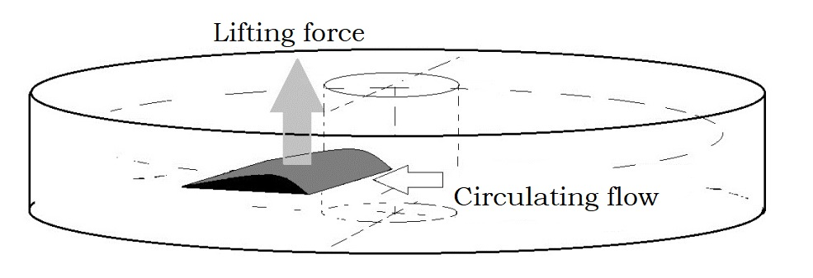
Wing in closed loop flow
It is scheme of experiment by Alexander Frolov, 1996.

Slide 7
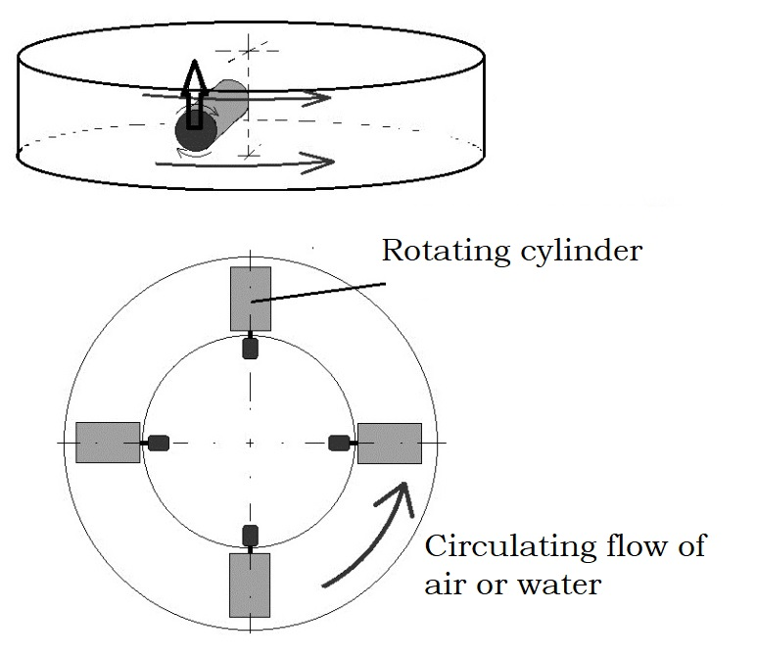
Propulsion by Magnus Force
Difference in relative speed lead to gradient of pressure. It is not reactive drive, it is the active drive. Here is no expenses of some propellant. Idea was offered by Alexander Frolov in 1996.

Slide 8
Magnus effect in Schauberger’s “repulsin”
“Repulsin” device by Schauberger use air flows. Also it is possible to use water or special gel for the same principle. Note on German group of 1996.
It is the same Magnus effect to create pressure gradient: water “vortex” moving to periphery and also it is rotating. Different velocity lead to gradient of pressure Up and DOWN

Slide 9
Lorenz Force as gradiend of Aether pressure
Considering magnetic field is rotation of Aether flow, we can accept the Lorenz force to be analogy with Magnus Effect. It is also active propulsion force due to gradient of Aether pressure.
This understanding of Lorenz force was published by Alexander Frolov in 1996-1998 years.

Slide 10
Usual forces between currents
Forces of attraction or repulsion between wires with electric currents
also are result of Aether gradient pressure.

Slide 11
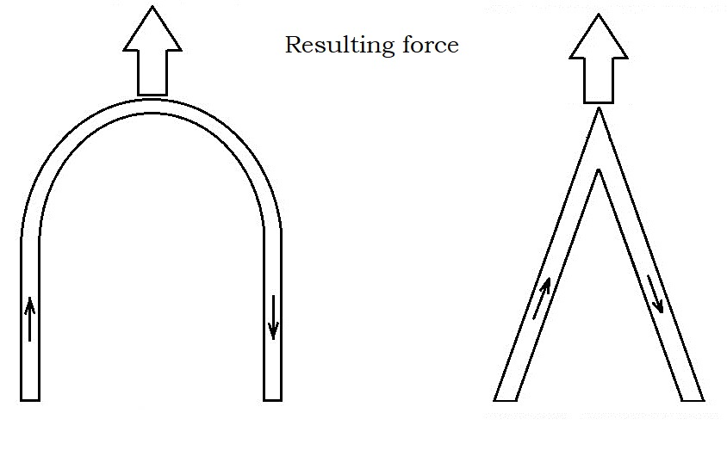
How to get electrokinetic propulsion force
1844 by the famous physicist Hermann G. Grassmann demonstrated non-zero resulting force in Y-shape wire of current (left picture). In modern publications (right) it is named Sigalov’s effect for U or V shape wires with current.

Slide 12
Cardioid schape current
Alexander Frolov made some experiments with cardioid shape wire with current.
Here is unidirectional propulsion force due to Grassmann effect.

Slide 13
Electrokinetic drive for microsatellites
Simplest experiments on electrokinetic were made by author in 1994-1997 with closed jar. There is oil circulation inside of the jar. Total sum force is not zero. The device demonstrated unidirectional propulsion force in axial direction. It can be applied for space projects to make correction of orbit of the satellites.
Problem: liquid is space cold area can not work without heating of the body.

Slide 14
Gradient of centrifugal force by Academician Albert Veinik
It was reproduced by Faraday Lab ltd. in 2002. Reason of the force is gradient of centrifugal force in R1 and R2 parts of trajectory

Slide 15
Gradeint of centrifugal force
Simple version of asymmetry of centrifugal force in device with liquid flow of mass. Total sum force is not zero. Here is unidirectional propulsion force due to gradient of acceleration. The idea was offered by the author in 1994, not tested yet.

Slide 16
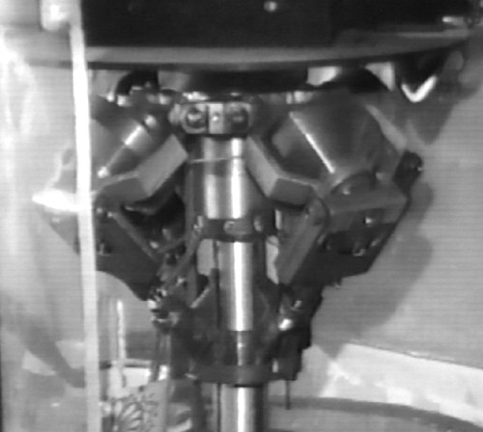
Dr. Spartak Polyakov and his gyroscopes of variable radius
Dr. Spartak M. Polyakov, Russia, experimented with gyroscopes of variable radius of orbit.

Slide 17
The principle of “variable radius”
Forced decrease of orbital radius of the gyroscope provide axial force. In mechanical devices Dr. Polyakov detected forces about 775 gram as unidirectional kinetic momentum.

Slide 18
Dr. Polyakov’s device with liquid
In this device of 1998 Dr. Polyakov use about 10 kg liquid metal rotor made of mercury.
Inside of the body there are tubes of spiral form to make the mercury provide effect of “variable radius gyroscope”.
Rotation is provided by electromotor.

Slide 19
Poliakov’s lab 1998 video

Slide 20
Results of experiments
Here is non-linear function of axial force with RPM. Here are good perspectives for real flying machines with this propulsion drive.

Slide 21
Frolov’s vortex drive
Alexander Frolov’s patent application
No. 2002128658/06 (030307), 25.10.2002.
This helical cone rotor make the liquid to move from big radius of rotation to small radius of rotation. Liquid try to resist since it try to increase its radius of rotation.
So, we provide axail propulsion force here.

Slide 22
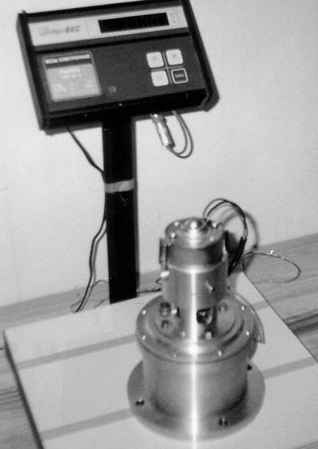
Experimental device in Faraday Lab ltd. 2002
We tested water not mercury. Axial force about 10 gram was detected. Water volume is about 0.2 liter.

Slide 23
Inverted pendulum to compensate weight
Here you can see direction of centrifugal force. In some parts of trajectory the weight of the device can be compensated by centrifugal force.

Slide 24
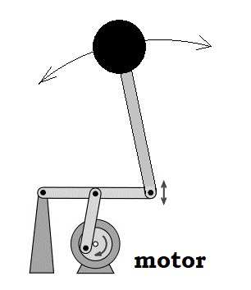
Inverter pendulum
The dynamic stabilization of an inverted pendulum was studied in detail by Academician Peter L. Kapitza in 1951.
Practical application as propulsion drive is possible for high frequency vibrators.

Slide 25
Tolchin’s inertial drive of 1936

Slide 26
How it works
Russian engineer V.N. Tolchin, in 1936 invented this principle.
In stage of acceleration of the masses by the motor, they are free.
In stage of deceleration of the masses, motor is Off and brake is On.
Propulsion force always have one direction for this device.

Slide 27
Norman Dean propulsion drive

Slide 28
How Dean drive works
Analogy with Tolchin’s device. Norman Dean also use brake in half-cycle of rotation to get asymmetry of forces Up and Down.

Slide 29
Brandson R. Thornson’s drive

Slide 30
Experimental device
This device was reproduced and tested by Alexander Frolov in 1998.

Slide 31
Russian inventor Konstantin Schukalov

Slide 32
Schukalov’s inertial drive
Two eccentrics move along a trajectory of constant radius, but their interaction is different: in one extreme position, they hit each other, the impulse is compensated. In the other extreme position, they hit the springs, transmitting two co-directional impulses to the body of the device. In result it is moving in one direction. Reported in 1996.

Slide 33
Floyd Sweet free energy generator
Floyd Sweet detected changes in weight of his free energy generator. Floyd used special magnet materials here. It works due to changes of magnetic poles direction. Here is also effect of precessing gyroscope but on the level of magnetic domens.

Slide 34
Precession of magnet momentum
Left side: usual magnetic material, co-directed magnetic moments of domens.
Right side: precession rotation of magnetic moments.
It works like precession of mechanical gyroscopes.

Slide 35
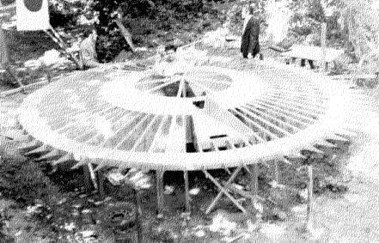
Special process of magnetization in Searl generators
Addition of a small component of a weak alternating current (about 100 mA) high frequency (about 10 MHz) in the process of making permanent magnets gives them new and unexpected properties. Larmor precession of the electron magnetic moment is the reason of propulsion force here. It is also precessing gyroscopes effect.

Slide 36
Russian version of Searl generator
The diameter of the magnetic system of the Godin and Roshchin converter (in the Astra project) was about 1 meter. The authors reported that at more than 500 rpm, self-rotation began, and the machine switched from the primary drive to the generator with a load of up to 7 kilowatts. Here is no special magnetic materials but in the process of work, the presence of axial vertical lift was noted, that is, a decrease in weight by 35% What is a reason???

Slide 37
Desing of ASTRA generator
Astra project do not use a “special magnets”. Axial lifting force were provided by ExH vector composition. Here we can assume the pondemotor effect for moving magnet in cross E-field.

Slide 38
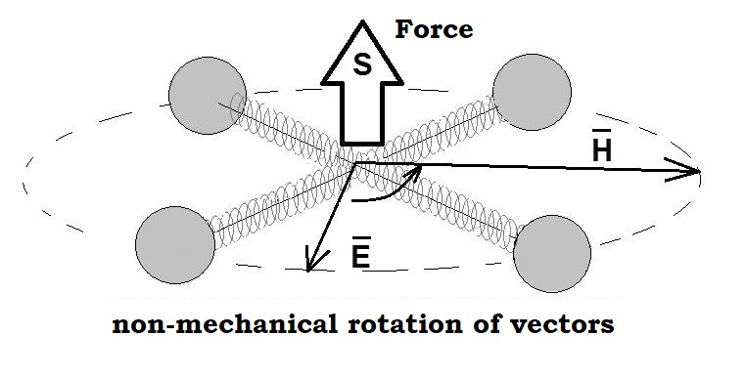
Pondemotor forces
Axial force can be created in this device without mechanical rotation of ExH vectors. It is classical pondemotor effect. The flow of energy is described as Poynting vector (in Russian textbook Umov – Poynting vector). The vector S on the picture.

Slide 39
Academician Ignatyev device
It was reported in 1996 by Academician Gennady Ignatyev for
International conference “New Ideas in Natural Sciences”, St.-Petersburg.
Size of about 4 meters, an operating frequency of 80 kHz, 10 kW input provide electric field 10 kV/m, and a magnetic field strength of about 200 kA/m. Propulsion force about 6 kg, with a total weight of the device was about 30 kg.

Slide 40
Academician Gennady Ignatyev
Report by Academician Ignayev was published in New Energy Technologies magazine #1, 2001 in English.
Download is free
http://www.faraday.ru
Letter from Kransnoyarsk State University ”Commission of experts has considered the article “Design of engine for free space based on the pondemotor effect” by Acad. Ignatyev. It can be submitted as non-secret publication since there is no information according to The Ch.3 of Rules of 1988 about publications, Department of Common and Professional Education, Russian Federation.
Chairman /sign/ Sorikin A.V.

Slide 41
Pondomotor effects in ferromaterials
Russian authors of G.P. Ivanov and Yu.G. Ivanov, Patent 2172865.
Here is radial E field between two cylinder electrodes and toroidal magnetic B field. Force is axial. Advantages are high frequency mode and small size of the propulsion drive. The best idea for space satellites.

Slide 42
Other idea on pondemotor effect
We can get the same effect with mechanically rotating permanent magnets and high voltage source. In this case we have not needs in powerful electric current to get magnetic field. Reference to Alexey Chekurkov’s effect.

Slide 43
Alexey Chekurkov device
Reference: Please make YouTube search in the net about “Alexey Chekurkov antigravity”.

Slide 44
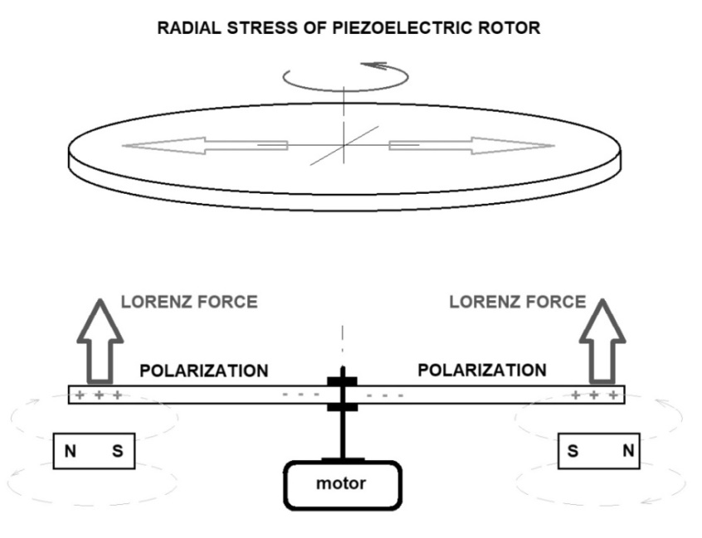
Frolov’s experiment of 1996 with piezoelectric disk
Axial force can be created in this device. To compare with ASTRA project here is no needs in High Voltage source. The disk can be electrically charged by piezoelectric effect due to deformations in radial direction during rotation. Cross fields ExH provide axial propulsion force in this device. Advantage is low energy input.

Slide 45
Frolov’s experiment of 1996

Slide 46
High voltage potential by friction
Besides piezoelectric disk we can use friction as easy method to get a very high voltage potential on the rotor. In this case we need some metal plates on the disk to collect electric charges. This method is used in electrophorus machines.

Slide 47
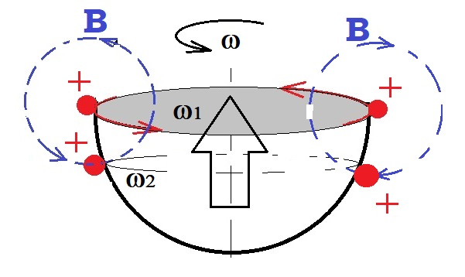
Rotating charged hemi-sphere
Simplest case of Lorenz force for rotating electrically charged hemi-sphere or disk.
Maximum magnetic field provide charges on maximum radius (max velocity). Other charges (small velocity) also produce magnetic field but total magnetic field is not zero.
Charges on surface provide axial Lorenz force.
Idea of experiment: Electrically charged hemi-sphere should demonstrate weight losses during rotation.

Slide 48
Explanation of T.T.Brown effect
In 1996 Alexander Frolov proposed explanation of T.T.Brown effect by asymmetry of electron orbits in dielectric material, if the electric field is gradient field. Analogy with mechanical devices of asymmetrical centrifugal force (slide about Acad. Veinik device).

Slide 49
Lifter by Jean Louis Naudin
In the “Lifter” design, to my mind, we can see geometrical asymmetry of electric forces. Sure, here is powerful ionization also. It is interesting but it is not a very perspective idea.

Slide 50
Jean Louis Naudin

Slide 51
Experiment with electroscope
What do you think about weight changes in this case? In the case of electrically charged plates of the electroscope we can see two lifting forces make some action of the plates. Here is vertical vector component also. I suppose we can use it for propulsion.

Slide 52
Frolov’s idea of 1994
Forces between electrostatically charged elements. It is not metal elements but dielectric elements. In this case we can see non-zero sum force F21 and zero for F12

Slide 53
Electrostatic Forces
Idea of 1994 by Frolov about forces in set of charged (polarized) dielectric elements. Sum of force for vertical element is about zero. Sum of forces for the horizontal plate is not zero. It was published in New Energy News magazine, USA, Salt Lake city, 1994 by Harold Fox.

Slide 54
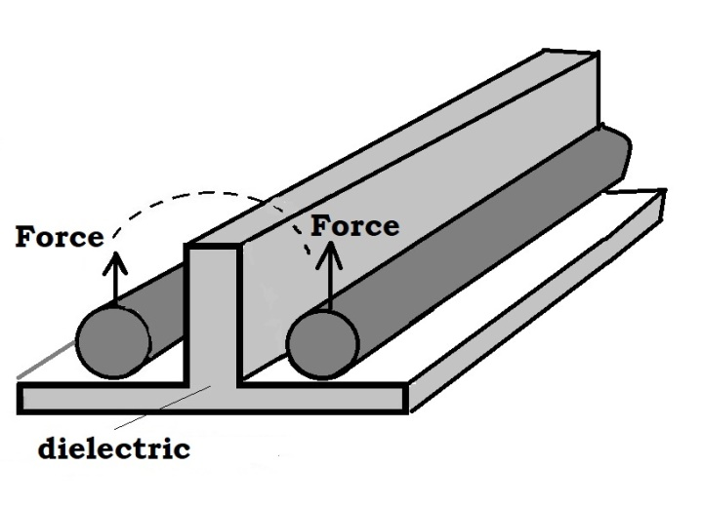
Frolov’s capacitor with T-shape dielectric
The T-shape capacitor at first time was demonstrated to Toyota aerospace department engineers in 1998, meeting in St.-Petersburg (the weight change).
It is metal rods or plates, separated by T-shape dielectric.

Slide 55
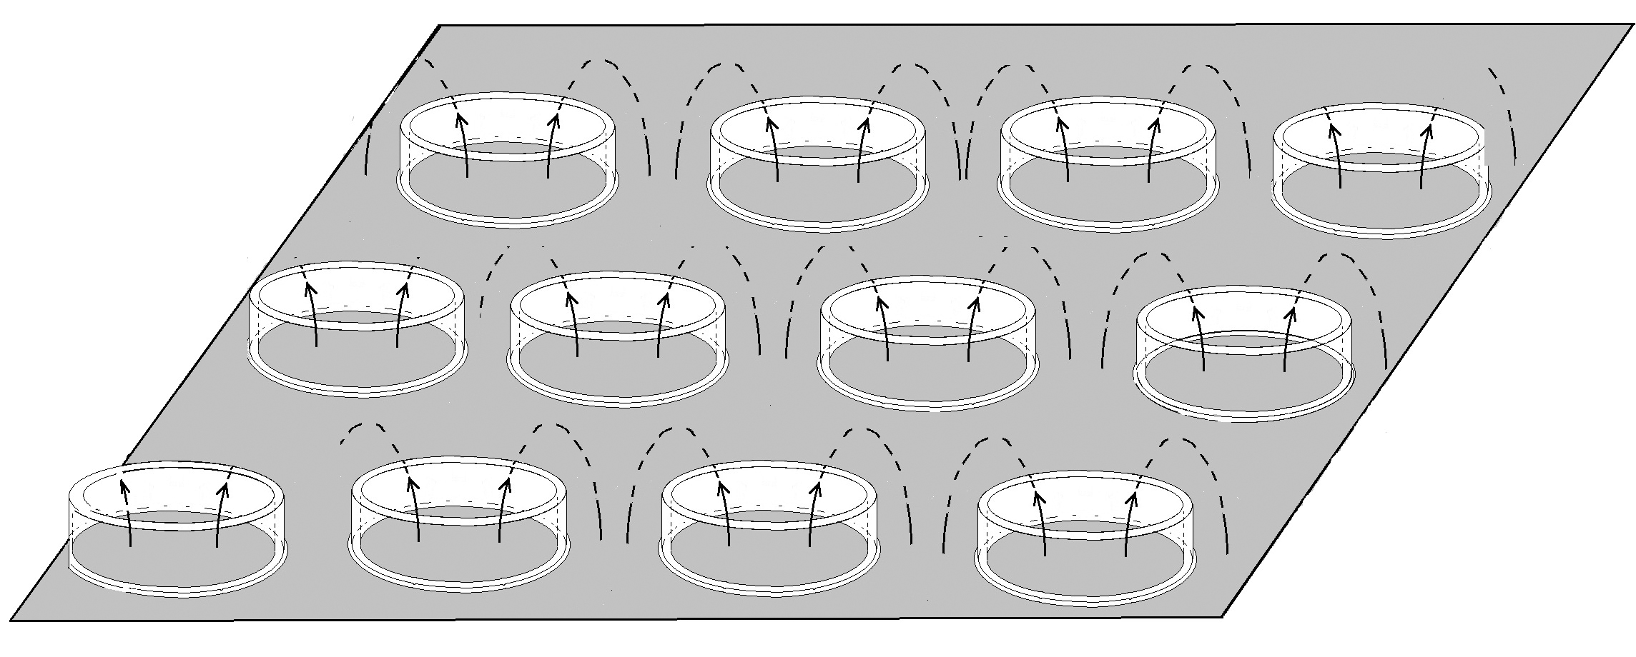
T-shape capacitor in ring version
Jean Louis Naudin tested this idea and named this version “Frolov’s Hat”
Small size elements are interesting idea for low voltage device

Slide 56
Electrostatic force against gravity

Slide 57
Elastic deformations
Interesting direction of research projects is elastic deformations of dielectric in gradient E-field. Pulsed mode of voltage can provide periodical non-linear deformations of the dielectric. It will lead to kinetic momentum for all device, so we can get here propulsion force. Power depend of frequency. High frequency can be provided in electrostriction materials. Author Alexander Frolov need help to test it and patent for commercialization.

Slide 58
Liquid dielectric in gradient field
Development of T.T.Brown’s ideas with liquid dielectric placed inside of gradiental E-field. Pulsed mode of voltage.

Slide 59
Force on board between two different dielectrics
It is textbook information about forces on board between two different dielectrics. Particles of matter on the board get force to the area of maximum of potential.

Slide 60
Why gradient work?
Example: some body is attracted to charged body since here is gradient of potential. It try to relocate in area of max potential. So, any gradient works by this way in two different dielectrics.

Slide 61
How to increase this effect
It was proposed to create many-layers dielectric to get powerful effect. More layers – more effect. Calculation give estimations about 1000 kg per sq.m. for 100 layers and 10kV potential on surface of this device. Frolov’s report of 1998 (published by Russian Academy of Sciences in 1999 in Proceedings of the conference). Patent claim № 2004105178 20.02.2004

Slide 62
Active Force Material
It is my mainstream project for 2021.
Alexander V. Frolov and his partners started it in 2003.
Several experiments were made to confirm the effect.
Weak but real results were measured for this concept.
This technology is not reactive but it is active propulsion method, i.e. the propulsion force is created here by means of gradient of pressure of environmental air or gas.
It works due to cooling of the environmental air.

Slide 63
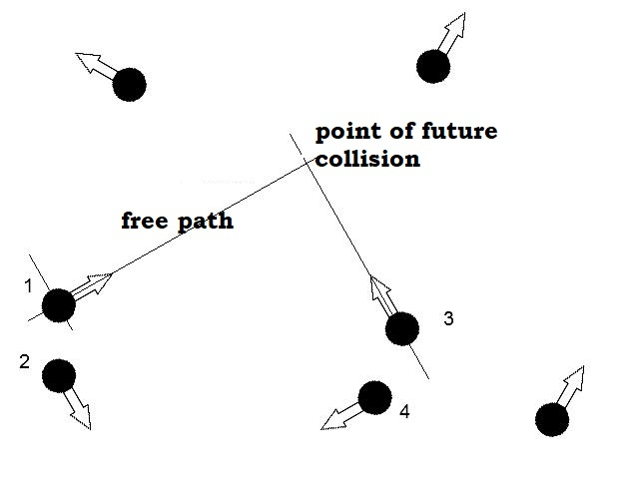
New application of nanotechnologies
It was started in 2003 after publication by Michael P. Beshok about “energy from air”. He proposed to use small relief (50-100 nm) to get gradient of air pressure and propulsion force. It works in scale of “free path”. Here is no statistical collisions of molecules with the surface. We can consider trajectory of every single molecule in sizes of “free path” so we can design some special relief.

Slide 64
Estimations on the force
It is names “Active Force Materials”. It works due to cooling of environmental air of gas, if we can take off part of kinetic energy of the gas molecules. So, this technology produce cold and propulsion force of great value (up to 1000kg force for 1 sq.m. in the case of 10% air pressure gradient).

Slide 65
Frolov’s idea on nanotubes
It is planned to get different air pressure on the plate from upper side and from bottom side. Theoretically, the gas molecules will loss part of their kinetic energy in the nanotubes.

Slide 66
Simple nanorelief to get gradient of air pressure
Simple relief can be produced by technology of microelectronics. Modern chip transistors have size about 100 – 7 nanometers, so this technology can provide special relief for Active Force Materials.

Slide 67
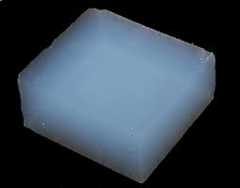
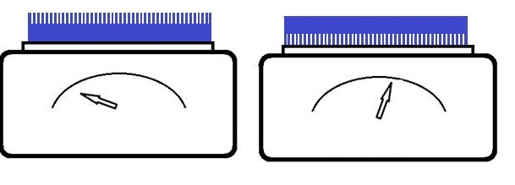
Experiments
In 2011-2012 Alexander V. Frolov made some experiments to confirm the effect with TiO2 open end nanotubes and also testes one-side aerogel device. It was measured some small weight changes.
Problem is water absorption from air.
Depend on humidity.

Slide 68
Gradient of pressure due to elastic-nonelastic properties
In this version we hope to get deformation of nanostructures in process of interaction with gas molecules. It is possible to use nanowires or nanohairs on one side of the plate to get gradient of air pressure. It is nanotech version of 1935 idea (next slide).

Slide 69
Experiment on elastic and inelastic interaction
The idea of the experiment was published by the author Harry W. Bull, in 1935.
Alexander Frolov reproduced it in 1996 for the conference New Ideas in Natural Sciences, St.-Petersburg (photo below).

Slide 70
Closed box with high pressure gas
It is possible to use Active Force Materials in closed box, so this propulsion technology can be used for aerospace. Heavy gas and high pressure provide more powerful propulsion forces. Heat source and heat exchange is necessary for open space version to provide energy exchange in this closed box. Here is no problem with humidity of the gas inside of the box.

Slide 71
Software for Active Force Materials
Alexander Frolov looking for partners to develop this project. It is useful to start this project with computer simulation software.
The algorithm here show idea of calculation of total vector sum in vertical and horizontal directions for one simple relief. It is necessary to find optimal relief form by means of computer simulation.

Slide 72
Gravimagnetic effects
William Hooper US Patent 3,610,971 All-Electric Motional Electric Field Generator. Bifilar coils have compensated E and H components but it provide distribution of Aether medium. So, in this experiments some weight changes were detected due to gravimagnetic effects.

Slide 73
Gravimagnetic effects by rotating current
Theory was described by Prof. Kyrill P. Butusov. Device was made and tested by Alexander Frolov, in Faraday Lab ltd with St.-Petersburg University. Propulsion force was not measured. Interesting practical application to reduce activity of isotopes was tested. The effect depend on value of current in the coil.

Slide 74
Experiments on gravity with HTSC
Experiments on antigravity were made in St.-Petersburg University by Contract with Faraday Lab Ltd. Gravity Force was detected by deviation of laser beam when HTSC phase was changed. Alexander Frolov described the reason of this effect as release of part of Aether in moment of change of HTSC phase of the disk.

Slide 75
Experimental setup to detect weight changes
One more experiment by Alexander Frolov. Weight changes about 0.01 – 0.04% were detected for this experiment. Conclusion: changes in phase state of HTSC disk by means of electric discharge provide gravity effects due to Aether wave.

Slide 76
Resonant frequency of gravity
Experiments with rotating HTSC disk with current in the disk were made to find resonant frequency of the gravity field. External magnetic field was applied in range 1Hz – 100 MHz. Maximum effect was detected for frequency about 30MHz.
It correspond to theory about oscilaltions of the gravity field by David Noever and Christopher Bremner, 35th AIAA/ASME/SAE/ASEE Joint Propulsion Conference, Los Angeles, CA, 20-23 June1999.

Slide 77
Propulsion drive by means of a conical superconductor
There are interesting experimental results in Greece:
Nassikas Athanassios A., 2015. “Magnetic propulsion device using superconductors” USA patent 8,952,773.
Nassikas Athanassios A., 2013 “Apparatus for generating a propulsive force using superconductors”, PCT patent application no. WO2013/110960 A1.
Nassikas Athanassios A., 2016. “Mechanism creating propulsive force by means of a conical coated tape superconducting coil”, PCT patent application no. WO2016/142721 A1.

Slide 78
How to use Time Delay for propulsion
When the magnetic field of the current pulse of the lower coil reaches the plane of the upper coil, a short current pulse can be created in it (stage 3). Other stages 1,2 and 4 have not force interaction. Important: it is interaction of EM fields, not a coils!

Slide 79
Thermogravity (static version)
Experiments were made to demonstrate weight changes in the case of powerful (anisotropic) heat radiation of the body.

Slide 80
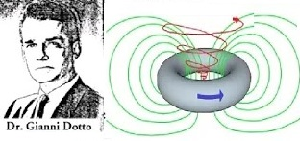
Dotto Ring (dynamics)
Intense directional heat transfer, for example, in a ring, from a heating element to a cooling element, creates a gravimagnetic effect. US Patent # 3,839,771, Method for Constructing a Thermionic Couple, October 8, 1974, Giani A. Dotto

Slide 81
Gravimagnetic by rotating plasma
Analogy with Dotto ring is rotation of plasma to get powerful gravimagnetic field and axial propulsion force. Plasma in toroidal shape case.
Publication by Alexander V. Frolov, Unipolar Generator with Plasma Disk, New Energy News, USA, 1994. In solid state disk we can get proton saturation (cathode in water). It is cold fusion topic. Material of disk can be some metal with affinity to hydrogen (palladium, nickel…) The rotation of this disk will create gravimagnetic field. No needs to play with plasma.
Two direction of rotation is necessary to compensate torque on the body of the device.
One more practical application of the gravimagnetic field is deactivation of isotopes (radioactivity wastes).

Slide 82
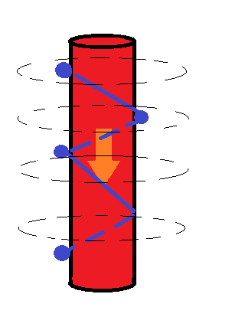
Gravimagnetic experiment with heat flow
Experiments with plasma are difficult to make at home. Here is another idea.
Simple experiment with vertical flow of hot water (or vapor) in some pipe.
Drops of water (or oil) on external surface of the pipe will move down by helical spiral instead of vertical line.
There is toroidal version by analogy with magnetic field of coil with electric current to get significant weight changes.

Slide 83
Antigravitation by means of cavity effect
Distance between nodes of the waves D = 2L (N+1)2K,
where N and K = 0, 1, 2…
L is the circumference of the tube, N is the number of the harmonic of standing waves of de Broglie matter, K is the number of the antinode ”
Victor Grebennikov discovered force effects for cavity (honeycomb) structures. Simple experiment allow to see real repulsion forces of two stems or bundles of grass. It is useful to find distance D for maximum of the effect. Prof. Zolotarev, St.-Petersburg, Russia.

Slide 84
De Broglie matter waves
Vibrations of atoms in one element of cavity structures (in some tube).
Radial vibrations are weak.
Axial vibrations are powerful.
All atoms produce De Broglie matter waves in Aether. It is free. No needs to spend fuel or energy to get the waves by this way. Regular cavity structures (honeycombs) produce powerful effects due to interference of the waves.

Slide 85
Flying platfrom
Victor Grebennikov and his flying platform

Slide 86
The Time Machine
Alexander V. Frolov and Vadim A. Chernobrov, 2003, Moscow

Slide 87
Experimental device made by Vadim Chernobrov

Slide 88
Experimental device in Faraday Lab Ltd.
Results of experiments were measured as 3% changes of time flow rate inside of the device. Antigravity propulsion force was not measured in this experiments.
Patent claim # №2003110067 April 09, 2003.

Slide 89
Three-turn coil
Problem is to get sinphase operation of several emitters to get effect in the central area of the device.
This three-turn "vibrator" create a wave of energy density in the Aether medium due to some phase shift in the propagation of the front of a current pulse, sequentially passing through three sections of current i1, i2, i3, which are displaced along the axis of the electromagnet by some distance d.

Slide 90
Development of the idea
Three-phase electric capacitors of spherical shape can provide convergent wave of Aether density. Here is no problem with synchronization of many emitters. By this way we can control the rate of time flow and gravity.

Slide 91
Many-layers solenoid
This solenoid was made by Alexander Frolov in 1991-1995 to test time rate changes and antigravity effects. Currents in many layers of this solenoid provide Aether vortex and chronal effects. Here is twisting of the Aether in the vortex.

Slide 92
Conclusion
Inertial, electrokinetic and asymmetrical capacitor methods can be applied for correction of satellite orbits (no needs in onboard propellant). Small force for the modern level of technology.
Most powerful non-reactive propulsion force can be made by ExH pondemotor effect. It can fly but with powerful onboard source of energy.
Nanotechnologies seems to be a very perspective topic as Active Force Material. No needs in powerful onboard source of energy. It work by cooling of environmental.
Propulsion by means of De Broglie matter waves (cavity effect) is real antigravity technology. It works today but it is dangerous for health of the humans to change natural Aether environmental.
Research on changes in “speed of time flow” also can be interesting to get new aerospace technology and for medical purposes.
All above is area of Aether-dynamics and this scientific direction should be recognized in modern science.

Slide 93
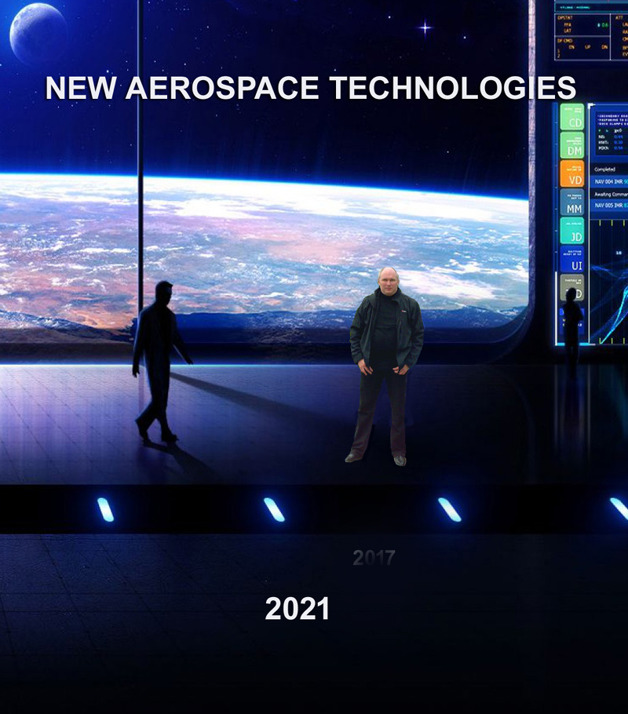
The Book
Detailed information about my experiments and other interesting technologies you can get from the book “New Aerospace Technologies”
Free download
http://www.faraday.ru/nat2021.pdf

Slide 94
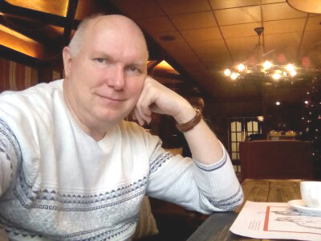
Contacts
Alexander V. Frolov
www.faraday.ru
Phone +7 980 7243309 WhatsApp

